Slide 1
Государственное бюджетное общеобразовательное учреждение Средняя общеобразовательная школа №580 Приморского района Санкт-Петербурга
Презентация по теме
«Ты-это то, что ты ешь!»
учителя английского языка
Омельченко Ленизы Раисовны

Slide 2
Watch video and guess the theme
https://www.youtube.com/watch?v=vLTgTH3Kems

Slide 3
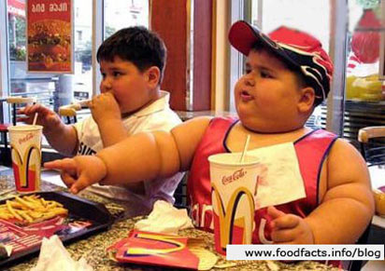
You are what you eat!
They lead healthy lifestyle.
They lead unhealthy lifestyle.

Slide 4
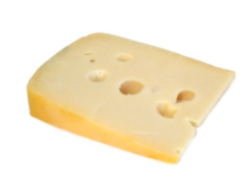
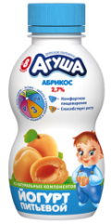
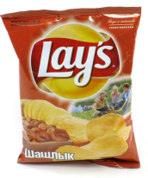
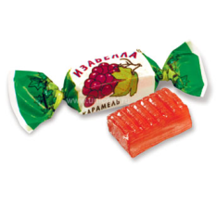
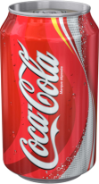
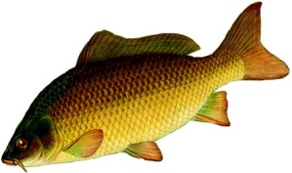
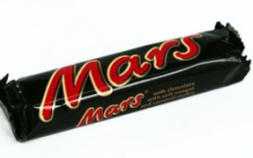
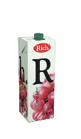
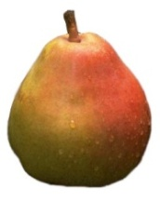
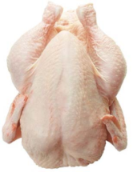
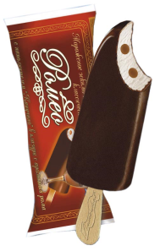
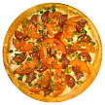
healthy food
unhealthy food

Slide 5
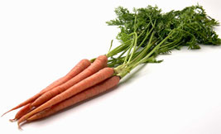
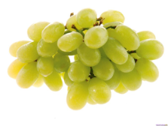
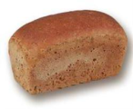
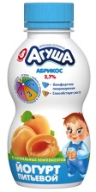
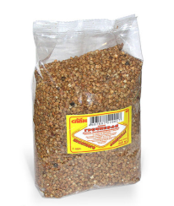
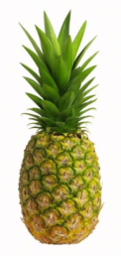
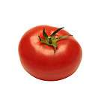
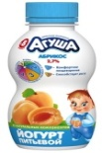
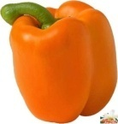
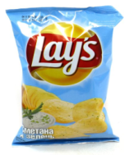
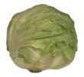
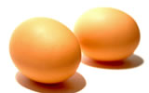
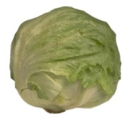
Food pyramid
1.
2.
3.
4.
5.
6.

Slide 6
Watch video and check your ideas
https://www.youtube.com/watch?v=IWHVbLx76bM

Slide 7
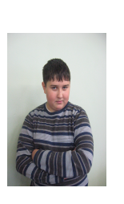
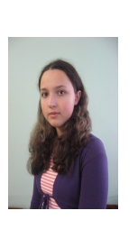
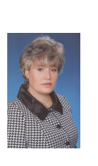
Match the expressions to the photos
*loves sweets
*likes junk food
*likes Mum's cooking
*dislikes meat and milk
*against fast food
*can't resist junk food
*is crazy about sweet
things
*eats fruit and vegetables
*always feels hungry

Slide 8
Give advice
should
shouldn’t
What should/shouldn't Dima eat?
What should/shouldn't L.R. eat?
shouldn’t
shouldn’t
Dima ………....eat hamburgers.
He ............. eat vegetables.
He ............. eat dairy products.
He ............. ...drink Cola.
He ............. eat fruit.
He .............
L.R. ............. ..eat a lot of sweets.
She ............. eat meat.
She ............. ...eat chocolates.
She ............. eat fruit.
She ............. drink milk.
She .............
should
should
should
shouldn’t
shouldn’t
should
should
should

Slide 9
Match the nicknames to the photos
" A junk food junkie"
"A health food nut"
"A sweet-tooth"
"A health food nut"
"A sweet-tooth"
" A junk food junkie"

Slide 10
Complete the dialogue and check it
Sorry, I can't.
Hello! Let's go to
McDonald's.
I'm on a diet. I don't eat hamburgers and I don't drink Cola.
Yes, I'm on a "sea" food diet.
Are you?!
Sorry, I can't.
Why?
Oh, no. I don't eat ice cream and fruit salad. They have a lot of calories, too.
Oh, no. I don't eat ice cream and fruit salad. They have a lot of calories, too.
Well. We can have fruit
salad and ice cream.
You know, I'm on a diet, too!
Why?
I'm on a diet. I don't eat hamburgers and I don't drink Cola.
You know, I'm on a diet,
too!
Are you?!
Oh!?
Yes, I'm on a "sea" food
diet.
What does it mean "sea
food diet"?
What does it mean "sea food diet"?
Well. We can have fruit
salad and ice cream.
It means "see and eat"!
Oh!?
It means "see and eat"!

Slide 11
Watch video and check your ideas
http://youtu.be/8tbjMXgte9Y.

Slide 12
How often do you go to Mc Donald's?
16% of pupils often go to Mc Donald's
81% of pupils sometimes go
3% of pupils never go

Slide 13
How often do you eat fruit and vegetables?
96% of pupils often eat
4% of pupils seldom eat

Slide 14
How often do you eat dairy products?
72% of pupils eat every day
28% of pupils sometimes eat

Slide 15
Do you drink Cola?
77% of pupils drink Cola
23% of pupils don't drink Cola

Slide 16
Junk food junkie
Johnny's got an addiction
He's strung without conviction.
He was raised with a 1. .................. .
Sticky, trashy, fast food slave!
He's a 2. .................. junkie,
He could be a lot more hunky,
But he's a junk food junkie.
Blame it on the food, yeah, you know it's
3. ...........!
Jenny's in a fix
With her 7. .................. .
Poor concentration-
Boys in the 8. .................. сause agitation.
She's a junk food junkie.
She could be a lot more funky.
But she's a junk food junkie.
Blame it on the food, yeah!
You know it's bad!
Bad!
microwave
arithmetic
junk food
classroom
bad
know
Mother doesn't really 4. ............. .
Shopping in a glossy show,
Then again, her budget's low,
Her health's so bad it makes her 5. ............ .
She's a junk food junkie.
She's 6. .................. and very jumpy.
She's a junk food junkie.
Blame it on the food, yeah, we know it's bad!
know
slow
classroom
slow
stressed
arithmetic
microwave
stressed
junk food
bad
Junk food is delicious and cheap, so young people love it.
Boys eat more junk food than girls.
Eating a lot of junk food is bad for your body and your mind.

Slide 17
Home task
"My healthy menu"
Write your healthy menu for one day using the information of this lesson.

Slide 18
Thank you!

